Slide 1
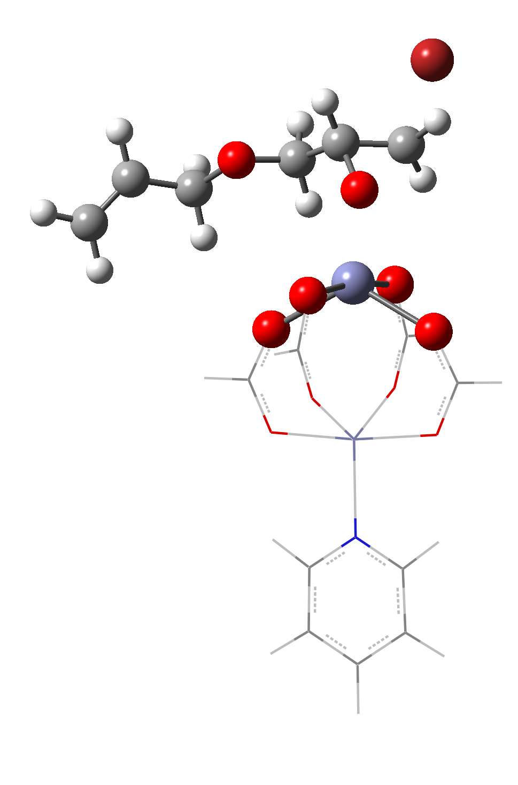
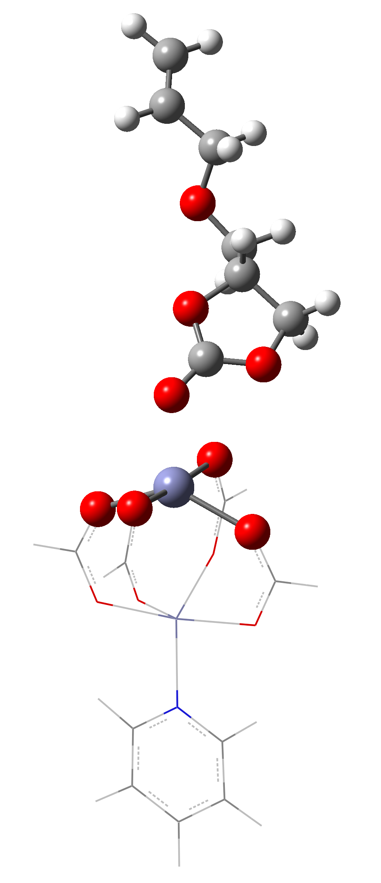
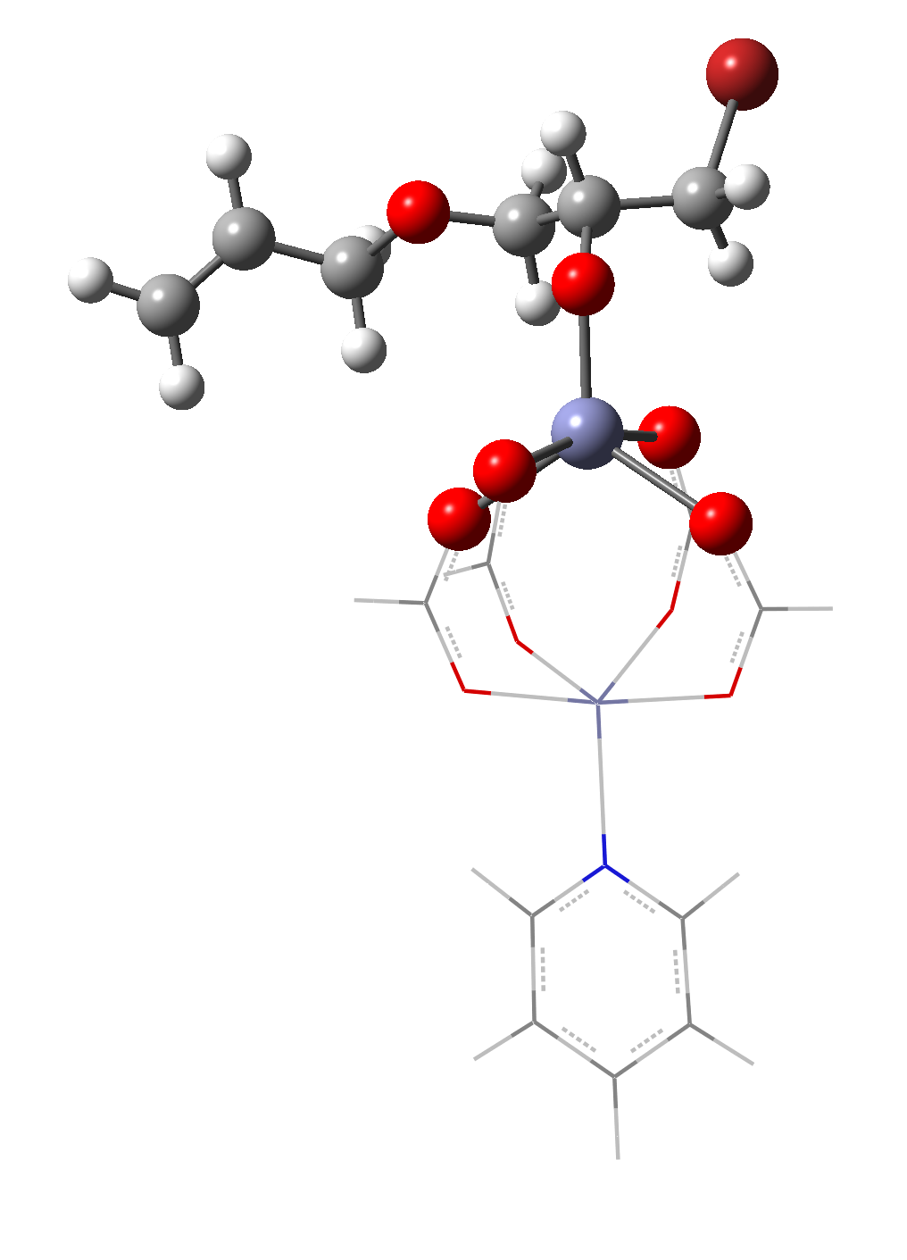
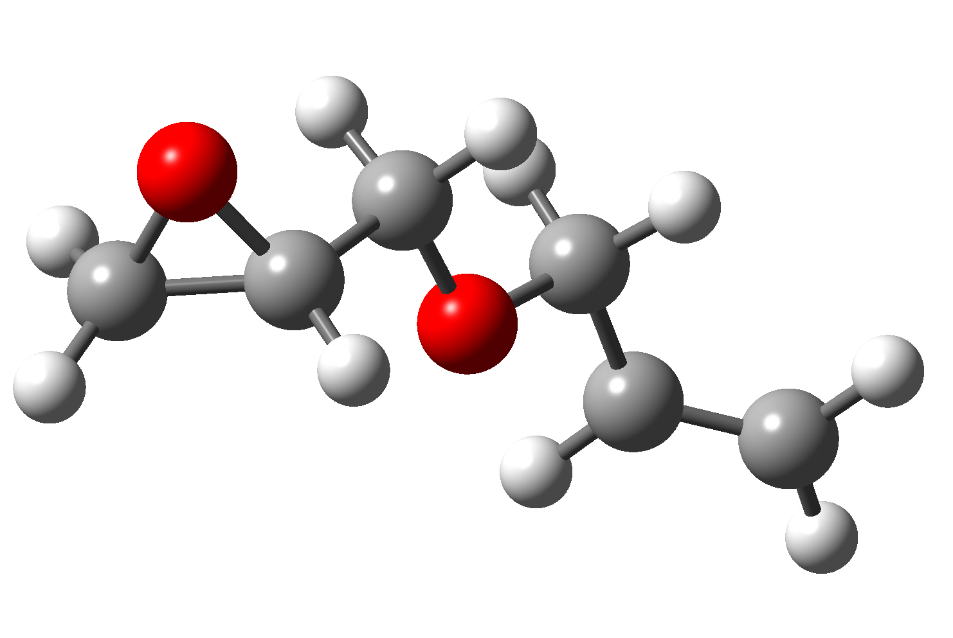
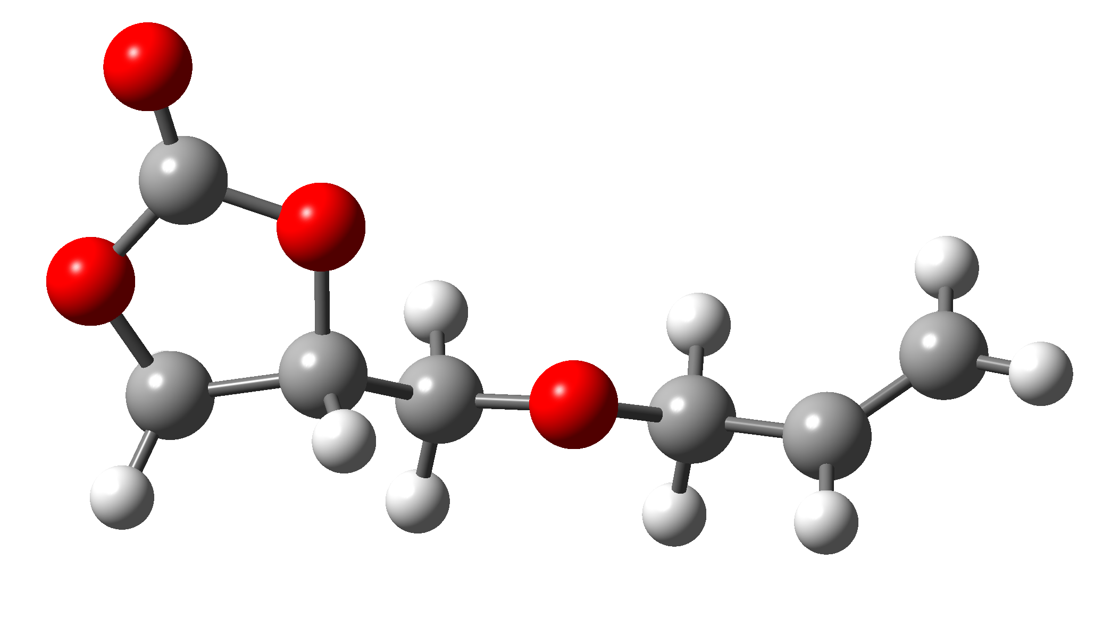
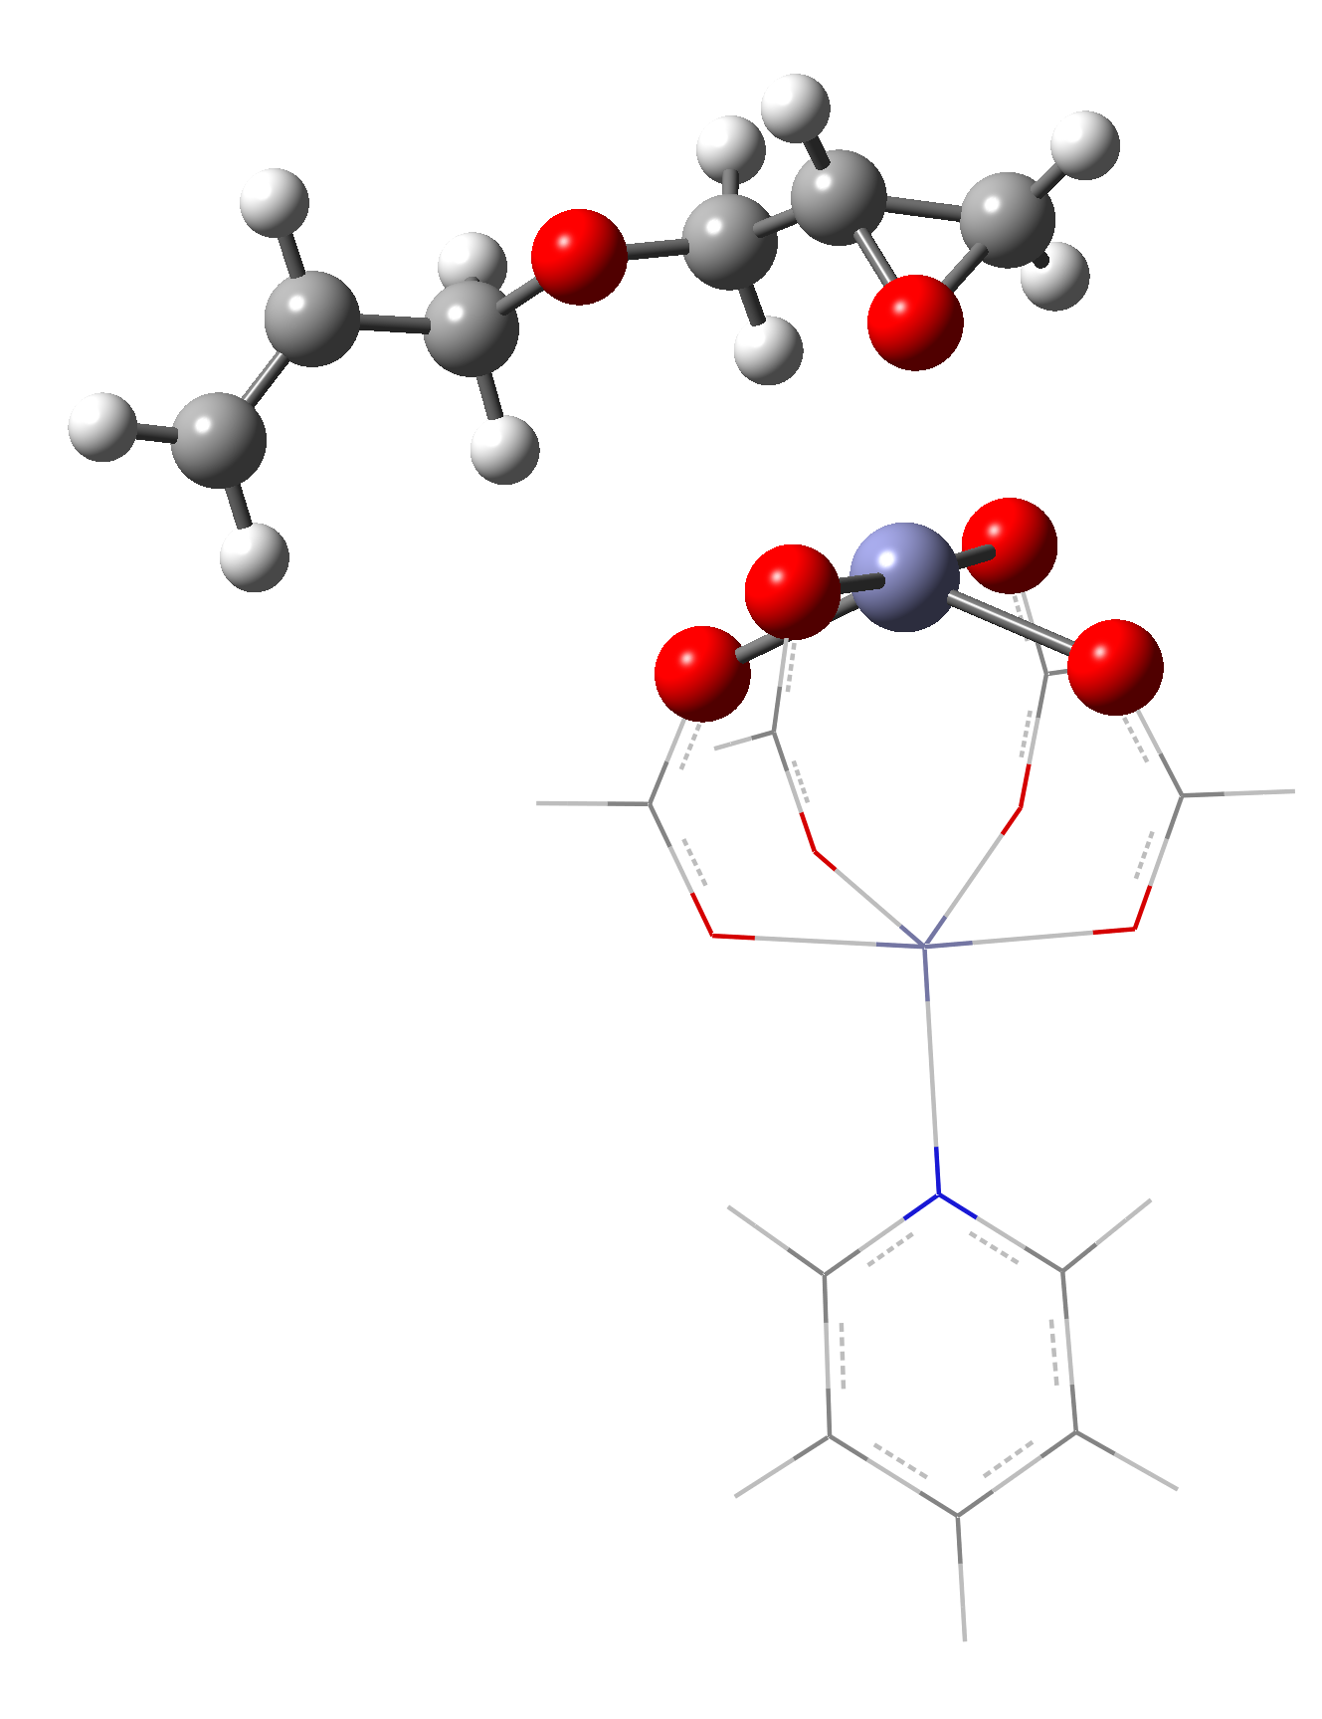
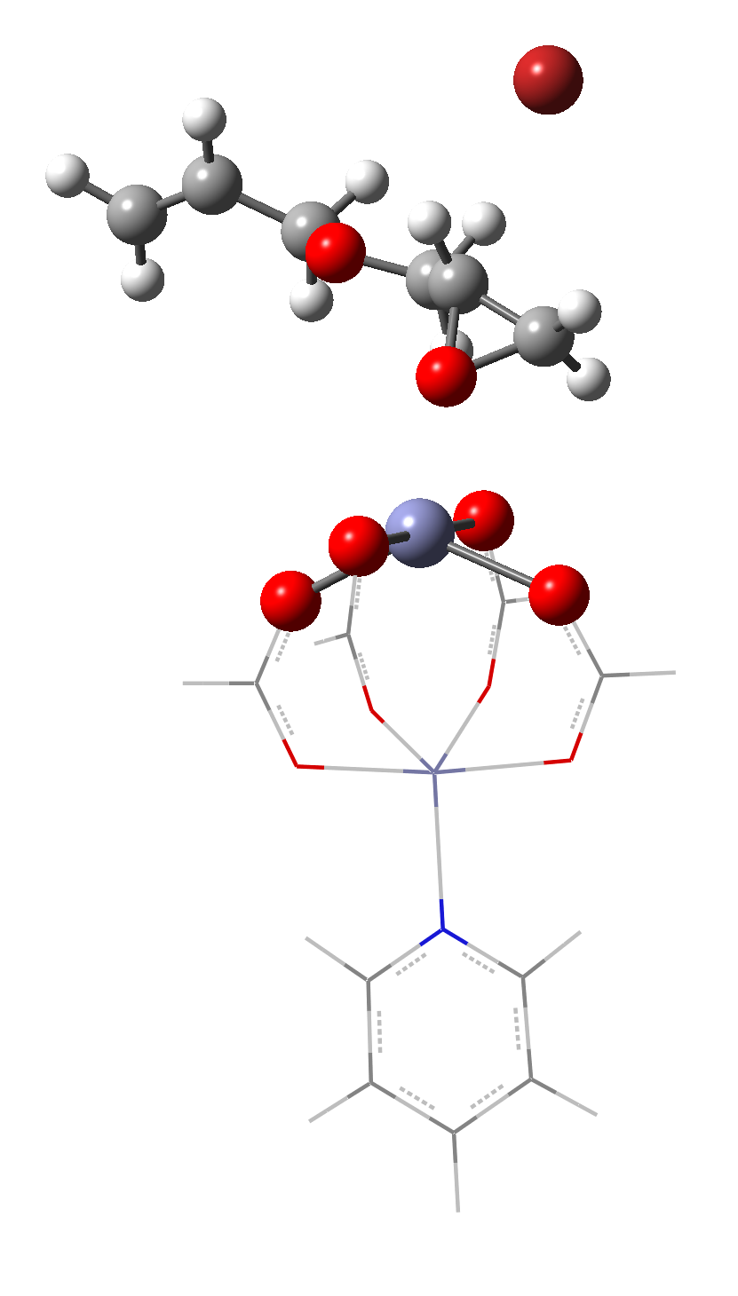
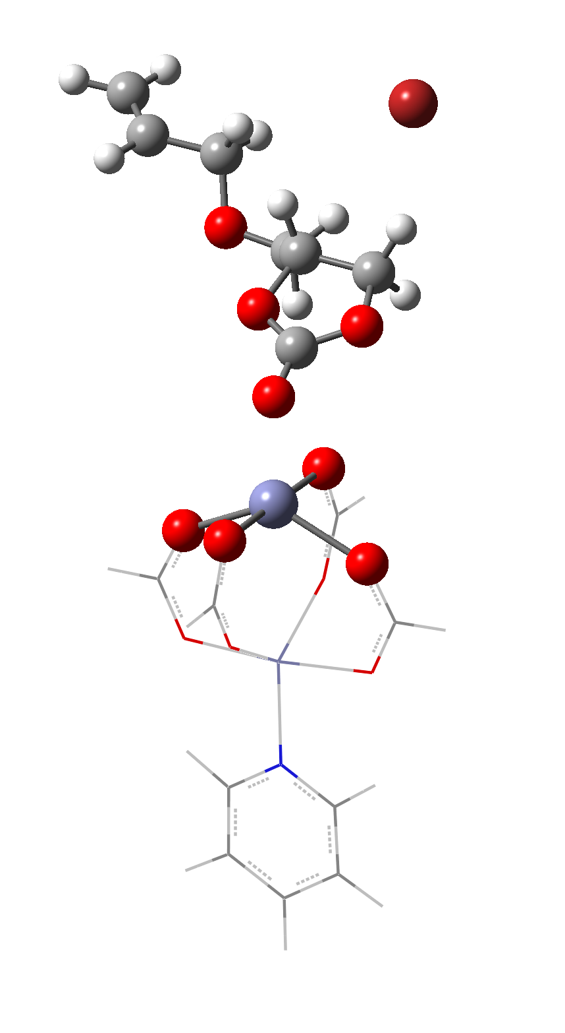
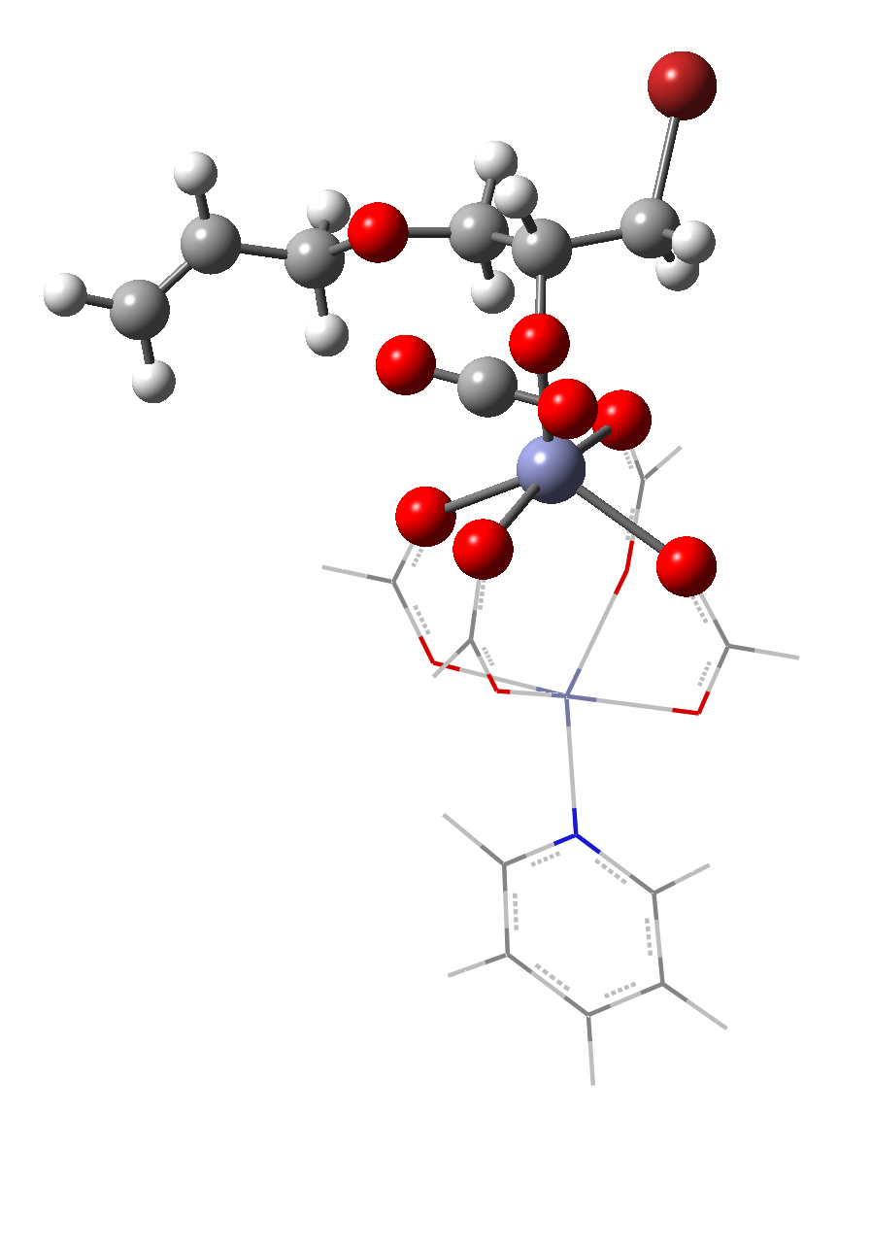
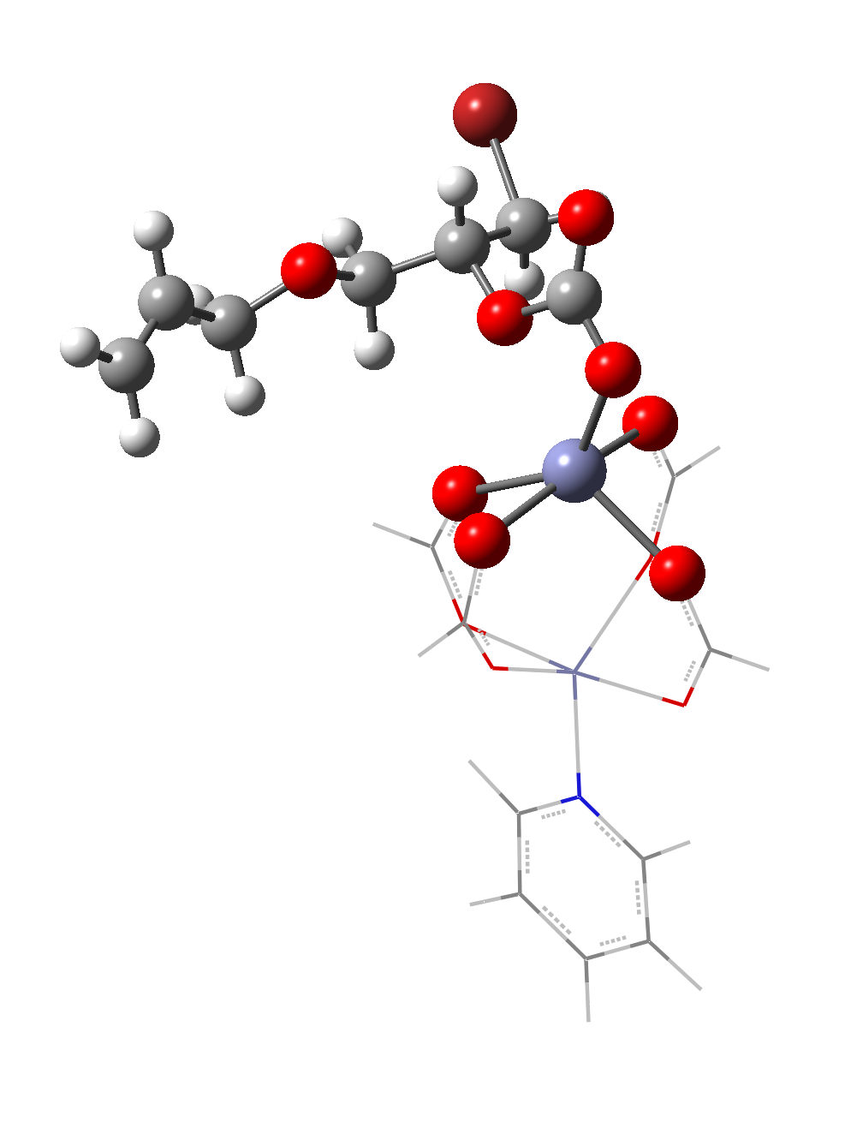









‡
0.0
AGE
AGE
$−$12.9
TS
$−$14.5
Int3
$−$15.9
Int1
TS
Int7
$−$22.9
AGC
$−$23.4
$−$25.6
AGC
Int2
Int3
$−$28.6
Int7
ΔE (kcal/mol)
Int4
$−$38.2
Int5
Int1
$−$49.8
Int6
Int2
Int4
Int6
Int5
Reaction Coordinate

